Slide 1
Module 1
Configuring and Troubleshooting Domain Name System
Notes:
Presentation: 90 minutes
Lab: 60 minutes
After completing this module, students will be able to:
Install and configure the Domain Name System (DNS) server role.
Create and configure DNS zones.
Configure DNS zone transfers.
Manage and troubleshoot DNS.
Required materials
To teach this module, you need the Microsoft® Office PowerPoint® file 20411D_01.pptx.
Important: We recommend that you use PowerPoint 2007 or a newer version to display the slides for this course. If you use PowerPoint Viewer or an older version of PowerPoint, all the features of the slides might not display correctly.
Preparation tasks
To prepare for this module:
Read all of the materials for this module.
Practice performing the demonstrations and the lab exercises.
Work through the Module Review and Takeaways section, and determine how you will use this section to reinforce student learning and promote knowledge transfer to on-the-job performance.
Preparation for Demos
There are six demonstrations in this module, and they require the virtual machines 20411D-LON-DC1, 20411D-LON-SVR1, and 20411D-LON-CL1. You should launch these virtual machines before each class begins, and sign in to them so that you can prepare for the demonstrations.
20411D
01: Configuring and Troubleshooting Domain Name System
(More notes on the next slide)

Slide 2
Notes:
Preparation for Labs
There is one lab at the end of this module. It requires the virtual machines 20411D-LON-DC1, 20411D-LON-SVR1, and 20411D-LON-CL1. Ask students to launch these virtual machines immediately, and sign in by using the credentials on the lab slide. This will prepare them for the lab.
20411D
01: Configuring and Troubleshooting Domain Name System

Slide 3
Module Overview
Configuring the DNS Server Role Configuring DNS Zones Configuring DNS Zone Transfers Managing and troubleshooting DNS
Notes:
20411D
01: Configuring and Troubleshooting Domain Name System

Slide 4
Lesson 1: Configuring the DNS Server Role
Components of a DNS Solution Demonstration: Installing the DNS Server Role What Are DNS Queries? What Are Root Hints? What Is Forwarding? How DNS Server Caching Works Demonstration: Configuring the DNS Server Role What Is DNS Round Robin? Considerations for Deploying the DNS Server Role
Notes:
20411D
01: Configuring and Troubleshooting Domain Name System

Slide 5
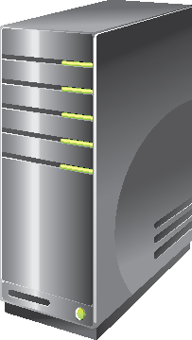

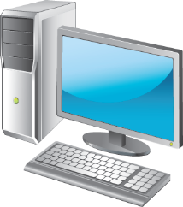



Components of a DNS Solution
Resource
Record
Root (.)
.com
Resource
Record
.edu
Internal DNS Servers
DNS Resolvers
DNS Servers on the Internet
Notes:
List the components of a DNS solution. Ask students to identify the elements that they have used for a DNS solution, such as a DNS client.
20411D
01: Configuring and Troubleshooting Domain Name System

Slide 6
Demonstration: Installing the DNS Server Role
In this demonstration, you will see how to install the DNS server role
Notes:
Leave the virtual machine running for subsequent demonstrations.
Preparation Steps
You require the 20411D-LON-DC1, 20411D-LON-SVR1, and 20411D-LON-CL1 virtual machines. Ensure that you have started 20411D-LON-DC1 and that the sign-in screen appears before starting 20411D-LON-SVR1 and 20411D-LON-CL1.
Demonstration Steps
On 20411D-LON-SVR1, sign in as Adatum\Administrator with the password Pa$$w0rd.
If necessary, on the taskbar, click Server Manager.
In Server Manager, in the navigation pane, click Dashboard, and then, in the details pane, click Add roles and features.
In the Add Roles and Features Wizard dialog box, click Next.
On the Select installation type page, click Role-based or feature-based installation, and then click Next.
On the Select destination server page, click Next.
On the Select server roles page, in the Roles list, select the DNS Server check box.
In the Add Roles and Features Wizard dialog box, click Add Features.
On the Select server roles page, click Next.
On the Select features page, click Next.
On the DNS Server page, click Next.
On the Confirm installation selections page, click Install.
After you have installed the role, click Close.
20411D
01: Configuring and Troubleshooting Domain Name System

Slide 7
What Are DNS Queries?
A query is a request for name resolution and is directed to a DNS server:
Queries are recursive or iterative
DNS clients and DNS servers initiate queries
DNS servers are authoritative or nonauthoritative for a namespace
An authoritative DNS server for the namespace will do one of the following:
Return the requested IP address
Return an authoritative “No”
A nonauthoritative DNS server for the namespace will do one of the following:
Check its cache
Use forwarders
Use root hints
Notes:
Explain that you use a DNS query to request name resolution, and that a query is sent to a DNS server. Briefly explain the two types of queries: recursive and iterative. Later topics in this lesson explain recursive and iterative queries in more detail.
Inform students that they should consider disabling recursion for specific domains. This prevents a DNS server from forwarding its DNS requests to another server. This can be useful when you do not want a particular DNS server communicating outside its network.
Describe how a DNS server makes an iterative query when it connects to another DNS server.
20411D
01: Configuring and Troubleshooting Domain Name System

Slide 8



What Are Root Hints?
Root hints contain the IP addresses for DNS root servers
Root (.) Servers
DNS Servers
Root Hints
.com
DNS Server
Microsoft
Client
Notes:
Describe the function of a root hint on the Internet and within an organization by referring to the slide.
Students should understand that root hints are relatively fixed. You can change an IP address for a root hint, but this is rare. If you remove root hints from a DNS server and do not set up forwarding, that DNS server will not be able to resolve DNS names outside its authoritative zone.
It is possible to add additional root hint servers. This is useful when an organization has multiple domains in the Active Directory® forest.
Perform the following procedure, and then demonstrate how to locate and view root hints:
Open the DNS console.
Right-click the server name, and then click Properties.
Show the root hints.
20411D
01: Configuring and Troubleshooting Domain Name System

Slide 9

What Is Forwarding?
A forwarder is a DNS server that is designated to resolve external or offsite DNS domain names
Forwarder
Root Hint (.)
Iterative Query
Ask .com
Iterative Query
Ask Contoso.com
.com
Recursive Query
131.107.0.11
Iterative Query
131.107.0.11
Authoritative Response
Recursive Query for
mail1.contoso.com
Contoso.com
Local
DNS
Server
Client
Notes:
Define forwarders and explain their purpose. Define conditional forwarding.
A conditional forwarder is a configuration setting on the DNS server that forwards DNS queries according to the query’s DNS domain name. For example, you can configure a DNS server to forward all queries that it receives for names that end with Contoso.com to the IP address of a specific DNS server or to the IP addresses of multiple DNS servers. Describe how conditional forwarding works by referring to the slide.
20411D
01: Configuring and Troubleshooting Domain Name System

Slide 10
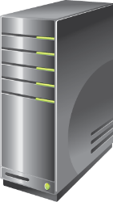

How DNS Server Caching Works
DNS server cache
Host name | IP address | TTL
ServerA.contoso.com | 131.107.0.44 | 28 seconds
Where is ServerA?
ServerA is at 131.107.0.44
Client1
Where is ServerA?
ServerA is at 131.107.0.44
Client2
ServerA

Slide 11
Demonstration: Configuring the DNS Server Role
In this demonstration, you will see how to:
Configure DNS server properties
Configure conditional forwarding
Clear the DNS cache
Notes:
Leave the virtual machine running for subsequent demonstrations.
Preparation Steps
The required virtual machines, 20411D-LON-DC1, 20411D-LON-SVR1, and 20411D-LON-CL1, should be running after the preceding demonstration.
Demonstration Steps
Configure DNS server properties
Switch to LON-DC1.
If necessary, sign in as Adatum\Administrator with the password Pa$$w0rd.
In Server Manager, click Tools, and then click DNS.
In DNS Manager, expand LON-DC1, select and right-click LON-DC1, and then click Properties.
In the LON-DC1 Properties dialog box, click the Forwarders tab.
On the Forwarders tab, click Edit. You can configure forwarding by typing the forwarding server’s IP address. Click Cancel.
Click the Advanced tab. You can configure options including securing the cache against pollution.
Click the Root Hints tab. You can see the configuration for the root hints servers here.
Click the Debug Logging tab, and then select the Log packets for debugging check box. You can configure debug logging options here.
Clear the Log packets for debugging check box, and then click the Event Logging tab.
Click Errors and Warnings.
Click the Monitoring tab. You can perform simple and recursive tests against the server by using the Monitoring tab. Select the A simple query against this DNS server check box, and then click Test Now.
Click the Security tab. You can define permissions on the DNS infrastructure here. Click Cancel.
20411D
01: Configuring and Troubleshooting Domain Name System
(More notes on the next slide)

Slide 12
Notes:
Configure conditional forwarding
In the navigation pane, click Conditional Forwarders.
Right-click Conditional Forwarders, and then click New Conditional Forwarder.
In the New Conditional Forwarder dialog box, in the DNS Domain box, type contoso.com.
Click the <Click here to add an IP Address or DNS Name> box. Type 131.107.1.2, and then press Enter. Validation will fail because this is an example configuration.
Click OK.
Clear the DNS cache
In the navigation pane, right-click LON-DC1, and then click Clear Cache.
Use Windows PowerShell® to configure the DNS server role
On the taskbar, click the Windows PowerShell icon.
At the Windows PowerShell command prompt, type Get-DnsServer, and then press Enter.
Observe the list of information that returns. You need to scroll up and down to read this information.
To see the same information one page at a time, you can pipe the output through the more function. Type Get-DnsServer | more, and then press Enter. Use the spacebar to advance one screen of text at a time or Enter to advance one line at a time. You can also pipe the output of the Get-DnsServer cmdlet to the Export-Clixml cmdlet, which generates an XML file of the configuration. You can use the XML file to back up or transfer DNS settings between computers.
Type Get-DnsServer | Export-Clixml –path c:\DNSExport.xml, and then press Enter.
Open File Explorer and the DNSExport.xml file. Point out some of the settings found there. Close the file and File Explorer.
Use the Windows PowerShell command-line interface to add a conditional forwarder. Type the following: Add-DnsServerConditionalForwarderZone –Name Fabrikam.com -MasterServers
(More notes on the next slide)
20411D
01: Configuring and Troubleshooting Domain Name System

Slide 13
Notes:
131.107.5.6, and then press Enter.
Return to the DNS console. In the navigation pane, click Conditional Forwarders.
Click the Refresh icon on the Tools ribbon. You should see both the Contoso.com and Fabrikam.com conditional forwarders items. In the console tree, select each item and verify the IP address settings.
20411D
01: Configuring and Troubleshooting Domain Name System

Slide 14



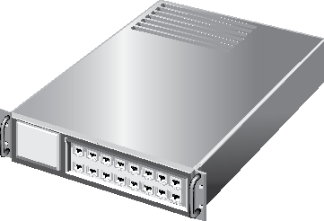


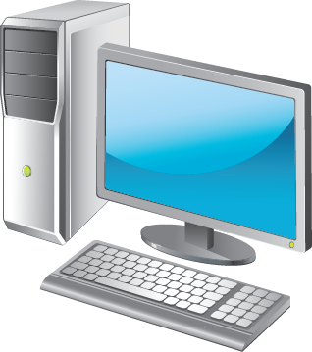

What Is DNS Round Robin?
What Is DNS Round Robin?
www.contoso.com 60 IN A 172.16.0.11
www.contoso.com 60 IN A 172.16.0.120
www.contoso.com 60 IN A 172.16.0.133
172.16.0.11
172.16.0.120
172.16.0.133
www.contoso.com
Register A records to DNS Zone
DNS Server for Contoso.com
Client sends http
‘get’ to
172.16.0.120
Client sends http ‘get’ to 172.16.0.11
Next DNS Client requests record for www.contoso.com
DNS returns records in list:
172.16.0.120
172.16.0.133
172.16.0.11
DNS returns records in list:
172.16.0.11
172.16.0.120
172.16.0.133
DNS Client requests record for www.contoso.com
Notes:
20687A
2: Upgrading and Migrating to Windows 8

Slide 15

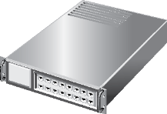

Considerations for Deploying the DNS Server Role
DNS Server
Subnet 2
DNS Zone
DNS Client
Subnet 1
DNS Client
DNS Server
Subnet 3
DNS Zone
DNS Client
Notes:
The following questions are helpful when considering a DNS server–role deployment:
If you are deploying DNS to support Active Directory Domain Services (AD DS), is the DNS server computer also a domain controller, or is it likely to be promoted to a domain controller in the future?
If the DNS server stops responding, are its local clients able to gain access to an alternate DNS server?
If the DNS server is located on a subnet that is remote to some clients, what other DNS servers or name-resolution options are available if the routed connection stops responding?
Mention that for many Active Directory issues, such as replication, nonfunctioning DNS servers can cause authentication problems.
20411D
01: Configuring and Troubleshooting Domain Name System

Slide 16
Lesson 2: Configuring DNS Zones
DNS Resource Records What Is a DNS Zone? DNS Zone Types What Are Active Directory–Integrated Zones? Forward and Reverse Lookup Zones Overview of Stub Zones Demonstration: Creating Zones DNS Zone Delegation What Is Split DNS?
Notes:
20411D
01: Configuring and Troubleshooting Domain Name System

Slide 17
DNS Resource Records
DNS resource records include:
SOA: Start of authority resource record
A: Host address resource record
CNAME: Alias resource record
MX: Mail exchanger resource record
SRV: Service locator resource record
NS: Name server resource record
AAAA: IPv6 host address resource record
PTR: Pointer resource record
Notes:
DNS resource records store information on the DNS server that relates a domain name to an IP address. Review the record types.
20411D
01: Configuring and Troubleshooting Domain Name System

Slide 18

What Is a DNS Zone?
Internet
“.”
DNS Root Domain
.com
microsoft.com domain
microsoft.com
www.microsoft.com
ftp.microsoft.com
example.microsoft.com
microsoft.com zone
WWW
FTP
Zone File
Delegated
example.microsoft.com
zone
WWW.example
example.microsoft.com
www.example.microsoft.com
ftp.example.microsoft.com
FTP.example
Zone File
Notes:
Define a DNS zone and explain its purpose. Discuss the characteristics of a DNS zone.
20411D
01: Configuring and Troubleshooting Domain Name System

Slide 19
DNS Zone Types
Zones | Description
Primary | Read/write copy of a DNS database
Secondary | Read-only copy of a DNS database
Stub | Copy of a zone that contains only records used to locate name servers
Active Directory– integrated | Zone data is stored in AD DS rather than in zone files
Notes:
Explain the four DNS zone types: primary, secondary, stub, and Active Directory–integrated.
20411D
01: Configuring and Troubleshooting Domain Name System

Slide 20



What Are AD DS Integrated Zones?
Normal replication traffic
Normal replication traffic
Normal replication traffic
Normal replication traffic
Normal replication traffic
Normal replication traffic
←-------------Domain Controllers----------→
←-------------Domain Controllers----------→
←-------------Domain Controllers----------→
Zone Transfer
Zone Transfer
Primary DNS Server Secondary DNS Server
Primary DNS Server Secondary DNS Server
Notes:
The slide title should be: “What Are Active Directory–Integrated Zones?”
“Zone transfer”
“Primary DNS Server”
Do the narrative sentences (below) need to swap for the first two slides?
Slide 21: The first click shows the added the primary and secondary DNS servers and shows the one-way zone transfer process.

Slide 21

Forward and Reverse Lookup Zones
Namespace: training.contoso.com
Forward zone | Training | DNS Client1 | 192.168.2.45
 |  | DNS Client2 | 192.168.2.46
 |  | DNS Client3 | 192.168.2.47
Reverse zone | 2.168.192.in-addr.arpa | 192.168.2.45 | DNS Client1
 |  | 192.168.2.46 | DNS Client2
 |  | 192.168.2.47 | DNS Client3
DNS Server Authorized
for Training
DNS Client2 = ?
192.168.2.46 = ?
DNS Client1
Notes:
Explain the purpose of DNS forward and reverse lookup zones.
20411D
01: Configuring and Troubleshooting Domain Name System

Slide 22


Overview of Stub Zones
Without stub zones, the ny.na.contoso.com server must query several servers to find the server that hosts the na.fabrikam.com zone
DNS
Server
Contoso.com
(Root domain)
DNS
Server
fabrikam.com
DNS
Server
DNS
Server
DNS
Server
na.contoso.com
sa.contoso.com
DNS
Server
DNS
Server
na.fabrikam.com
ny.na.contoso.com
rio.sa.contoso.com
Notes:
When a zone that a DNS server hosts is a stub zone, the DNS server is a source only for information about the zone’s authoritative name servers. The zone on this server must be obtained from another DNS server that hosts the zone.
The DNS server must have network access to the remote DNS server to copy the zone’s authoritative name server information. Ensure that students understand that you use the stub zone mainly to shorten the delay in querying for records in a foreign zone, while also being made aware of changes to the NS records in that foreign zone.
Begin a classroom discussion by explaining that stub zones and conditional forwarding provide similar functions.
20411D
01: Configuring and Troubleshooting Domain Name System

Slide 23
Demonstration: Creating Zones
In this demonstration, you will see how to:
Create a reverse lookup zone
Create a forward lookup zone
Notes:
Leave the virtual machine running for subsequent demonstrations.
Preparation Steps
The required virtual machines, 20411D-LON-DC1, 20411D-LON-SVR1, and 20411D-LON-CL1, should be running after the preceding demonstration.
Demonstration Steps
Create a reverse lookup zone
On LON-DC1, in DNS Manager, in the navigation pane, click Reverse Lookup Zones.
Right-click Reverse Lookup Zones, and then click New Zone.
In the New Zone Wizard, click Next.
On the Zone Type page, click Primary zone, and then click Next.
On the Active Directory Zone Replication Scope page, click Next.
On the Reverse Lookup Zone Name page, click IPv4 Reverse Lookup Zone, and then click Next.
On the second Reverse Lookup Zone Name page, in the Network ID box, type 172.16., and then click Next.
On the Dynamic Update page, click Next.
On the Completing the New Zone Wizard page, click Finish.
Re-register LON-DC1 into the zone by doing the following:
Right-click the Windows® Start icon, and then select Run.
In the Run dialog box, in the Open text area, type cmd and then click OK.
At the command prompt, type ipconfig /registerdns, and then press Enter. Close the command prompt window.
Return to the DNS console, and under the Reverse Lookup Zones, select 16.172.in-
20411D
01: Configuring and Troubleshooting Domain Name System
(More notes on the next slide)

Slide 24
Notes:
addr.arpa.
On the keybord, press F5, and then verify that the Pointer (PTR) record for 172.16.0.10 appears.
Create a forward lookup zone
Switch to LON-SVR1.
Pause your pointer over the lower-left corner of the display, and then click Start.
On the Start screen, type DNS, and then, from the Search results, click the second DNS icon.
In DNS Manager, in the navigation pane, expand LON-SVR1, and then click Forward Lookup Zones.
Right-click Forward Lookup Zones, and then click New Zone.
In the New Zone Wizard, click Next.
On the Zone Type page, click Secondary zone, and then click Next.
On the Zone Name page, in the Zone name box, type Adatum.com, and then click Next.
On the Master DNS Servers page, in the Master Servers list, type 172.16.0.10, and then press Enter.
Click Next, and on the Completing the New Zone Wizard page, click Finish.
Create a forward lookup zone with Windows PowerShell
Switch to LON-DC1.
On the taskbar, click the Windows PowerShell icon.
In the Windows PowerShell window, type Add-DnsServerPrimaryZone –Name woodgrovebank.com –DynamicUpdate Secure –ReplicationScope Domain, and then press Enter.
(More notes on the next slide)
20411D
01: Configuring and Troubleshooting Domain Name System

Slide 25
Notes:
Return to the DNS console. In the console tree, expand LON-DC1, and then expand and refresh Forward Lookup Zones. You should see the woodgrovebank.com zone.
Select and right-click the woodgrovebank.com zone, and then click Properties.
On the General tab, confirm that Replication is set to All DNS servers in this domain, and that Dynamic Updates are set to Secure only.
Click Cancel on the woodgrovebank.com Properties page.
20411D
01: Configuring and Troubleshooting Domain Name System

Slide 26
DNS Zone Delegation
DNS Server
Contoso.com
DNS Zone
DNS Subdomain
DNS Zone
Sales
DNS Server
Marketing
Notes:
Explain how to use DNS zone delegation. DNS provides the option of dividing a namespace into one or more zones, which you then can store, distribute, and replicate to other DNS servers.
Explain why you would use delegation. When explaining why you use it, emphasize the difference between zones and domains. Consider demonstrating the process for creating a DNS zone delegation.
20411D
01: Configuring and Troubleshooting Domain Name System

Slide 27








What Is Split DNS?
Internal DNS servers host domain computer records, plus mail and Web server in perimeter subnet
External DNS server hosts only records that are resolved from the outside mail and Web server
Web Server
Mail Server
External
DNS Server
Inside Firewall
–
Outside Firewall
Domain Controllers
Running ADI DNS
Perimeter Subnet
Clients and servers on the internal network send all DNS queries to Domain controllers/Active Directory–Integrated servers.
Servers and Computers on
Domain-Joined, Internal Network
Notes:
If you use the same namespace for your AD DS as for your external domain namespace, you must be careful to segregate the name servers for that namespace. External queries should be able only to resolve names such as www or ftp. External queries should not be able to resolve names such as HQDC01 or FILESERVER10. This requires that publicly accessible DNS servers host a zone for your domain that you maintain manually and that contains only the records that are appropriate for external resolution. All systems within the domain should point to separate, internal DNS servers that provide full resolution for all names in the domain.
You might need to duplicate some records. For example, if you want your internal users to be able to access your external website, you might need to add the www record to the internally hosted zone. Similarly, if you want partners to be able to access portal.contoso.com, that record needs to be in both the public and internal zones. This configuration is quite common, and it is called split or split-brain DNS.
You should also mention how Active Directory–integrated DNS zones can use split DNS to ensure that outside-the-firewall users never access the Active Directory–integrated DNS zone, while still allowing internal users to find outside-the-firewall websites and other servers by forwarding name resolution from the internal Active Directory–integrated DNS servers to the external DNS server.
20411D
01: Configuring and Troubleshooting Domain Name System

Slide 28
What Is Split DNS?
Internal DNS servers host domain computer records, plus mail and Web server in perimeter subnet
External DNS server hosts only records that are resolved from the outside: mail and Web server
Web Server
Mail Server
External
DNS Server
Inside Firewall
Outside Firewall
Domain Controllers
Running ADI DNS
Perimeter Subnet
Internal requests to perimeter subnet Web and mail servers are allowed to go to those servers after resolving names from Active Directory–Integrated DNS servers
Servers and Computers on
Domain-Joined, Internal Network
Notes:
The internal DNS servers can resolve IP addresses for internal clients that need access to servers on the perimeter network, such as the corporate Web server.
20411D
01: Configuring and Troubleshooting Domain Name System

Slide 29
What Is Split DNS?
Internal DNS servers host domain computer records, plus mail and Web server in perimeter subnet
External DNS server hosts only records that are resolved from the outside: mail and Web server
Web Server
Mail Server
External
DNS Server
Inside Firewall
Outside Firewall
Domain Controllers
Running ADI DNS
Perimeter Subnet
Requests to resolve resources outside of the domain and perimeter subnet are forwarded to the external DNS server, which uses iterative queries to root hints or another forwarder to resolve those queries.
Servers and Computers on
Domain-Joined, Internal Network
Notes:
Internal DNS servers forward any requests to resolve names for Internet-level resources to the external DNS server, which has no internal records at all except for the perimeter network servers. This means that this server either iteratively searches through root hints or a forwarder, if set.
20411D
01: Configuring and Troubleshooting Domain Name System

Slide 30

What Is Split DNS?
Internal DNS servers host domain computer records, plus mail and Web server in perimeter subnet
External DNS server hosts only records that are resolved from the outside: mail and Web server
Web Server
Mail Server
External
DNS Server
Inside Firewall
Outside Firewall
Domain Controllers
Running ADI DNS
Perimeter Subnet
Clients and servers on the internal network send all DNS queries to Domain controllers/Active Directory–Integrated DNS servers
Servers and Computers on
Domain-Joined, Internal Network
Notes:
The external DNS server in the perimeter network receives a query from the Internet. If the query is for the servers located on the perimeter network, such as the corporate Web server, the external DNS server resolves it. However, if the query is for any internal resources that are hosted on the Active Directory–integrated DNS servers, the external server simply does not have these records, and because its zone name is the same, it issues an authoritative rejection of that query. Also, the inside firewall rejects all DNS queries coming into the internal network.
20411D
01: Configuring and Troubleshooting Domain Name System

Slide 31
Lesson 3: Configuring DNS Zone Transfers
What Is a DNS Zone Transfer? Configuring Zone Transfer Security Demonstration: Configuring DNS Zone Transfers
Notes:
20411D
01: Configuring and Troubleshooting Domain Name System

Slide 32
What Is a DNS Zone Transfer?
A DNS zone transfer is the synchronization of authoritative DNS zone data between DNS servers
1
SOA query for a zone
2
SOA query answered
3
IXFR or AXFR query for a zone
4
IXFR or AXFR query answered
(zone transferred)
Secondary Server
Primary and
Master Server
Notes:
Define zone transfer, and describe the purpose and process of zone transfers. Describe the DNS zone transfer process by referring to the slide. Emphasize the importance of keeping zones up-to-date and synchronized.
Briefly discuss the two types of DNS zone transfers:
A AXFR occurs when the entire zone copies from one DNS server to another.
An incremental zone transfer (IXFR) occurs when there is an update to the DNS server and only the resource records that were changed replicate to the other server.
Make sure to highlight that Active Directory–integrated zones are replicated as part of AD DS replication events, whereas standards-based zone transfers are transferred by using DNS zone-transfer queries.
20411D
01: Configuring and Troubleshooting Domain Name System

Slide 33


Configuring Zone Transfer Security
Restrict zone transfer to specified servers
Encrypt zone transfer traffic
Consider using Active Directory–integrated zones
Primary Zone
Secondary Zone
Notes:
Zone information provides a lot of information about an organization. Take precautions to protect it from hackers and against being overwritten with bad data, which is known as DNS poisoning. Students should know that they can secure zone transfers to protect a DNS infrastructure.
Explain that you can set a list of trusted servers that might transfer the zone. You also can use these options to disallow zone transfers and to transfer data to any server that requests it. Explain that you can use Internet Protocol security (IPsec) or virtual private networks (VPNs) to secure zone transfers.
Explain that using Active Directory–integrated zones can further secure a zone. Using Active Directory–integrated zones replicates the zone data as part of normal Active Directory replications.
20411D
01: Configuring and Troubleshooting Domain Name System

Slide 34
Demonstration: Configuring DNS Zone Transfers
In this demonstration, you will see how to:
Enable DNS zone transfers
Update the secondary zone from the master server
Update the primary zone, and verify the change on the secondary zone
Notes:
Leave the virtual machine running for subsequent demonstrations.
Preparation Steps
The required virtual machines, 20411D-LON-DC1, 20411D-LON-SVR1, and 20411D-LON-CL1, should be running after the preceding demonstration.
Demonstration Steps
Enable DNS zone transfers
Switch to LON-DC1.
In DNS Manager, in the navigation pane, expand Forward Lookup Zones.
Right-click Adatum.com, and then click Properties.
In the Adatum.com Properties dialog box, click the Zone Transfers tab.
Select the Allow zone transfers check box, and then click Only to servers listed on the Name Servers tab.
Click Notify, and then, in the Notify dialog box, click Servers listed on the Name Servers tab. Click OK.
Click the Name Servers tab, and then click Add.
In the New Name Server Record dialog box, in the Server fully qualified domain name (FQDN) box, type LON-SVR1.Adatum.com, and then click Resolve. Continue even if it gets a red X; it will be set after the OK. Click OK.
In the Adatum.com Properties dialog box, click OK.
To use Windows PowerShell for the same actions above:
Open the Windows PowerShell Administrator console on LON-DC1.
Type the following cmdlet, and then press Enter:
Set-DnsServerPrimaryZone -Name "adatum.com" –Notify Notify -SecondaryServers
20411D
01: Configuring and Troubleshooting Domain Name System
(More notes on the next slide)

Slide 35
Notes:
“172.16.0.21” –SecureSecondaries TransferToSecureServers
Update the secondary zone from the master server
Switch to LON-SVR1.
In DNS Manager, in the navigation pane, expand Forward Lookup Zones.
Refresh the display, right-click Adatum.com, and then click Transfer from Master. If successful, you will see the various Adatum.com DNS zone records, similar to the same zone in the DNS console of LON-DC1. You might need to perform this step a number of times before the zone transfers. Also, note that the transfer might occur automatically before you perform these steps manually.
To use Windows PowerShell for the same actions above:
Open the Windows PowerShell Administrator console on LON-SVR1.
Type the following cmdlet, and then press Enter:
Add-DnsServerSecondaryZone -Name "Adatum.com" -ZoneFile "Adatum.com.dns" -MasterServers 172.16.0.10
Note: The secondary zone “Adatum.com” was already created on LON-SVR1 in the previous demonstration. Attempting to create it in Windows PowerShell without first deleting it will result in a Windows PowerShell error.
Update the primary zone, and then verify the change on the secondary zone
Switch to LON-DC1.
In DNS Manager, right-click Adatum.com, and then click New Alias (CNAME).
In the New Resource Record dialog box, in the Alias name (uses parent domain if left blank) box, type intranet.
In the Fully qualified domain name (FQDN) for target host box, type LON-dc1.adatum.com, and
(More notes on the next slide)
20411D
01: Configuring and Troubleshooting Domain Name System

Slide 36
Notes:
then click OK.
Switch to LON-SVR1.
In DNS Manager, click Adatum.com.
Right-click Adatum.com, and then click Transfer from Master. The record might take some time to appear. You might need to refresh the display.
20411D
01: Configuring and Troubleshooting Domain Name System

Slide 37
Lesson 4: Managing and troubleshooting DNS
TTL, Aging, and Scavenging Demonstration: Managing DNS Records Demonstration: Testing the DNS Server Configuration Monitoring DNS by Using the DNS Event Log Monitoring DNS by Using Debug Logging Monitoring DNS with Windows PowerShell
Notes:
20411D
01: Configuring and Troubleshooting Domain Name System

Slide 38
TTL, Aging, and Scavenging
Feature | Description
TTL | Indicates how long a DNS record will remain valid
Aging | Occurs when records that have been inserted into the DNS server reach their expiration and are removed
Scavenging | Performs DNS server resource record grooming for old records in DNS
Notes:
Explain how Time to Live (TTL), aging, and scavenging will help students manage DNS records. These DNS tools help keep a DNS database clean and accurate.
Ensure that students understand that TTL is the amount of time a DNS record is considered valid. Describe the purpose of aging and scavenging. If left unmanaged, the presence of stale resource records in zone data might cause problems.
20411D
01: Configuring and Troubleshooting Domain Name System

Slide 39
Demonstration: Managing DNS Records
In this demonstration, you will see how to:
Configure TTL
Enable and configure scavenging and aging
Notes:
Leave the virtual machine running for subsequent demonstrations.
Preparation Steps
The required virtual machines, 20411D-LON-DC1, 20411D-LON-SVR1, and 20411D-LON-CL1, should already be running after the preceding demonstration.
Demonstration Steps
Configure TTL
Switch to LON-DC1.
In DNS Manager, right-click Adatum.com, and then click Properties.
In the Adatum.com Properties dialog box, click the Start of Authority (SOA) tab.
In the Minimum (default) TTL box, type 2, and then click OK.
Enable and configure scavenging and aging
Right-click LON-DC1, and then click Set Aging/Scavenging for All Zones.
In the Server Aging/Scavenging Properties dialog box, select the Scavenge stale resource records check box, and then click OK.
In the Server Aging/Scavenging Confirmation dialog box, select the Apply these settings to the existing Active Directory–integrated zones check box, and then click OK.
To use Windows PowerShell for the same actions above:
Open the Windows PowerShell Administrator console on LON-DC1.
Type the following cmdlets, and then press Enter after each one:
Set-DnsServerScavenging -RefreshInterval 7.00:00:00 -Verbose -PassThru
Set-DnsServerZoneAging adatum.com -Aging $true -PassThru -Verbose
20411D
01: Configuring and Troubleshooting Domain Name System

Slide 40
Demonstration: Testing the DNS Server Configuration
In this demonstration, you will see how to use Nslookup.exe to test the DNS server configuration
Notes:
Revert all virtual machines.
Preparation Steps
The required virtual machines, 20411D-LON-DC1, 20411D-LON-SVR1, and 20411D-LON-CL1, should be running after the preceding demonstration.
Demonstration Steps
On LON-DC1, pause your pointer over the lower-left corner of the display, and then click the Windows icon.
On the Start screen, type cmd, and then press Enter.
In the Search results pane, click Command Prompt.
At the command prompt, type the following command, and then press Enter:
nslookup -d2 LON-DC1.Adatum.com
Review the information provided by Nslookup.
20411D
01: Configuring and Troubleshooting Domain Name System

Slide 41
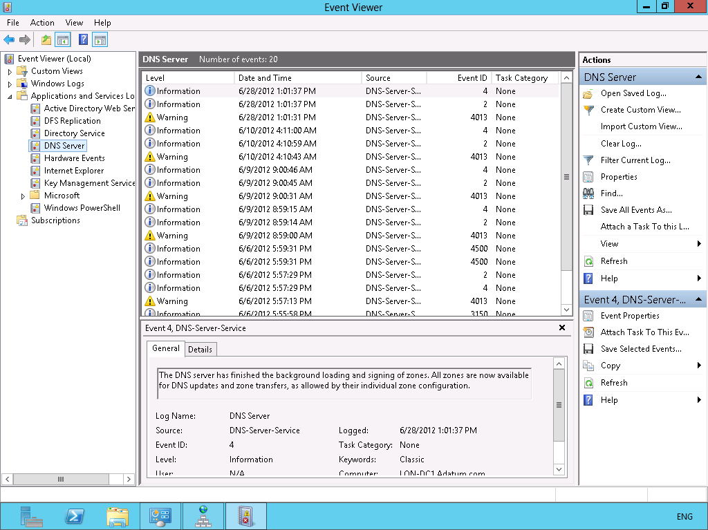
Monitoring DNS by Using the DNS Event Log
Notes:
Explain how to monitor DNS by using the DNS event log.
Describe the common types of DNS events that might appear in the DNS event log.
20411D
01: Configuring and Troubleshooting Domain Name System

Slide 42
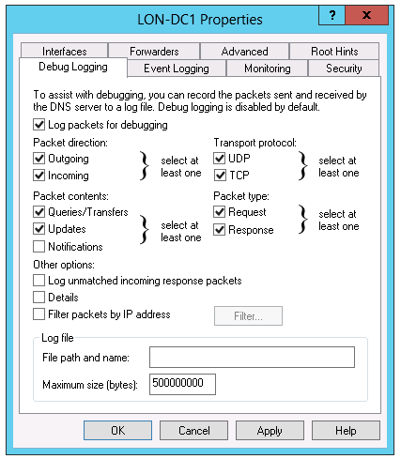
Monitoring DNS by Using Debug Logging
Notes:
Describe and demonstrate the following:
Enable debug logging and output to a file.
Examine the file’s contents.
20411D
01: Configuring and Troubleshooting Domain Name System

Slide 43
Monitoring DNS with Windows PowerShell
Windows Server 2012 has added Windows PowerShell cmdlets for DNS configuring, managing, monitoring, and troubleshooting
Windows Server 2012 R2 has added DnsServerStatistics parameters
Windows Server 2012 R2 also added Windows PowerShell cmdlets for DNSSEC
Notes:
You might want to open File Explorer and go to the Forward Link that was referenced in the Workbook to explore some of the DNS cmdlets. Mention that DNS Security Extensions (DNSSEC) is an advanced concept that requires a certification authority or public key infrastructure, which is beyond the scope of this module.
20411D
01: Configuring and Troubleshooting Domain Name System

Slide 44
Lab: Configuring and Troubleshooting DNS
Exercise 1: Configuring DNS Resource Records Exercise 2: Configuring DNS Conditional Forwarding Exercise 3: Installing and Configuring DNS Zones Exercise 4: Troubleshooting DNS
Logon Information
Virtual machines: 20411D-LON-DC1, 20411D-LON-SVR1,
20411D-LON-CL1
User name: Adatum\Administrator
Password: Pa$$w0rd
Estimated Time: 60 minutes
Notes:
Exercise 1: Configuring DNS Resource Records
You have been asked to add several new resource records to the DNS service on LON-DC1. Records include a new MX record for Exchange Server 2010, and an SRV record that is required for a Lync Server 2013 deployment that is taking place currently. You also have been asked to configure a reverse lookup zone for the domain.
Exercise 2: Configuring DNS Conditional Forwarding
You have been asked to configure internal name resolution between A. Datum and its partner organization, Contoso.
Exercise 3: Installing and Configuring DNS Zones
A small branch office has reported that name resolution performance is poor. The branch office contains a Windows Server 2012 server that performs several roles. However, there is no plan to implement an additional domain controller.
You have been asked to install the DNS server role at the branch office, and then create a secondary zone of Adatum.com. To maintain security, you also have been instructed to configure the branch office server to be on the Notify list for Adatum.com zone transfers. You also should update all branch office clients to use the new name server in the branch office, and then configure the new DNS server role to perform standard aging and scavenging, as needed and specified by corporate policy.
Exercise 4: Troubleshooting DNS
After implementing the new server, you need to test and verify the configuration by using standard DNS troubleshooting tools.
20411D
01: Configuring and Troubleshooting Domain Name System

Slide 45
Lab Scenario
A. Datum Corporation is a global engineering and manufacturing company with its head office in London, United Kingdom. An Information Technology office and a data center are located in London to support the head office and other locations. A. Datum recently deployed a Windows Server 2012 server and client infrastructure.
Management has asked you to add several new resource records to the DNS service that is installed on LON-DC1. Records include a new MX record for Exchange Server 2013 and a SRV record for a Microsoft Lync® Server 2013 deployment that is occurring.
Notes:
20411D
01: Configuring and Troubleshooting Domain Name System

Slide 46
Lab Scenario
A. Datum is working with a partner organization, Contoso, Ltd. You have been asked to configure internal name resolution between the two organizations. A small branch office has reported that name resolution performance is poor. The branch office contains a Windows Server 2012 server that performs several roles. However, there is no plan to implement an additional domain controller. You have been asked to install the DNS server role at the branch office and to create a secondary zone of Adatum.com. To maintain security, you have been instructed to configure the branch office server to be on the Notify list for
Notes:
20411D
01: Configuring and Troubleshooting Domain Name System

Slide 47
Lab Scenario
Adatum.com zone transfers. You also should update all branch office clients to use the new name server in the branch office.
You should configure the new DNS server role to perform standard aging and scavenging, as necessary and as specified by corporate policy. After implementing the new server, you need to test and verify the configuration by using standard DNS troubleshooting tools.
Notes:
20411D
01: Configuring and Troubleshooting Domain Name System

Slide 48
Lab Review
In the lab, you were required to deploy a secondary zone because you were not going to deploy any additional domain controllers. If this condition changed—that is, if LON-SVR1 was a domain controller—how would that change your implementation plan?
Notes:
Question
In the lab, you were required to deploy a secondary zone because you were not going to deploy any additional domain controllers. If this condition changed—that is, if LON-SVR1 was a domain controller—how would that change your implementation plan?
Answer
You could install the AD DS and DNS roles, and then you would not need to configure any zone transfers.
20411D
01: Configuring and Troubleshooting Domain Name System

Slide 49
Module Review and Takeaways
Review Question(s) Tools
Notes:
Review Question(s)
Question
You are deploying DNS servers into an Active Directory domain, and your customer requires that the infrastructure be resistant to single points of failure. What must you consider while planning the DNS configuration?
Answer
You must ensure that you deploy more than one DNS domain controller in the network.
Question
What is the difference between recursive and iterative queries?
Answer
A client issues a recursive query to a DNS server. It can have only two possible replies: the IP address of the domain requested, or the host is not found. An iterative query resolves IP addresses through the hierarchal DNS namespace. An iterative query returns an authoritative answer or the IP address of a server that is on the next level down in the DNS hierarchy.
Question
What must you configure before a DNS zone can transfer to a secondary DNS server?
Answer
You must configure DNS zone transfers to allow the secondary zone server to transfer from the primary zone.
Question
You are the administrator of a Windows Server® 2012 DNS environment. Your company recently acquired another company. You want to replicate their primary DNS zone. The acquired company is using Berkeley Internet Name Domain (BIND) 4.9.4 to host its primary DNS zones. You notice a significant amount of traffic between the Windows Server 2012 DNS server and the BIND server. What is one possible reason for this?
20411D
01: Configuring and Troubleshooting Domain Name System
(More notes on the next slide)

Slide 50
Notes:
Answer
BIND 4.9.4 does not support IXFR. Each time a change occurs in the BIND zone, it has to replicate the entire zone to a computer that is running Windows Server 2012 to remain updated.
Question
You must automate a DNS server configuration process so that you can automate the deployment of Windows Server 2012. What DNS tool can you use to do this?
Answer
You can use Dnscmd.exe for this purpose.
Tools
Tool
Use for
Where to find it
Dnscmd.exe
Configure the DNS server role
Command-line
Dnslint.exe
Test a DNS server
Download from the Microsoft website and then use from the command-line
Nslookup.exe
Test DNS name resolution
Command-line
Ping.exe
Simple test of DNS name resolution
Command-line
Ipconfig.exe
(More notes on the next slide)
20411D
01: Configuring and Troubleshooting Domain Name System

Slide 51
Notes:
Verify and test IP functionality and view or clear the DNS client resolver cache
Command-line
20411D
01: Configuring and Troubleshooting Domain Name System

